Slide 1

Blinkit Analysis Project
-Vaishali Yadav

Slide 2
Overview
1
2
3
4
5
Introduction
KPI
Insight
Steps in project
Power BI dashboard

Slide 3

Introduction
The primary goal of this project to offer a clear, data driven analysis of blinkit’s operation. It highlights key metrices such as total sales, average sales, average ratings and no. of items. By visualizing the data this dashboard will help stakeholders to make informed decisions, optimize strategies and improve overall performances.

Slide 4
Key performane indicator
Total sales: $1.20M
No. of items: 8523
Average sales: $141
Average rating: 3.9

Slide 5
Insights
Sales by fat content: low fat-$425.36K in sales, regular fat: $776.32k in sales
Sales by item type: Top selling categories include Fuits and vegetables and snak foods, each contributing $0.18m
Outlet details: outlet establishment trend – sales trend peaked in 2018 at $205k, showing a slight decline afterward.
Outlet size: high size - $507.90k, medium size - $248.99k, small size - $444.79k
Outlet location: tier 1 - $336.40k, tier 2 - $393.15k, tier 3 – 472.13k
Outlet type: supermarket type 1 dominates sales with $787.55k followed by grocery store with $151.94k.

Slide 6
Steps in project
Requirement gathering
Data walkthrough
Data connection
Data cleaning
Data modelling
Data processing
DAX calculation
Charts development and formatting
Dashboard/report development
Insights generation

Slide 7
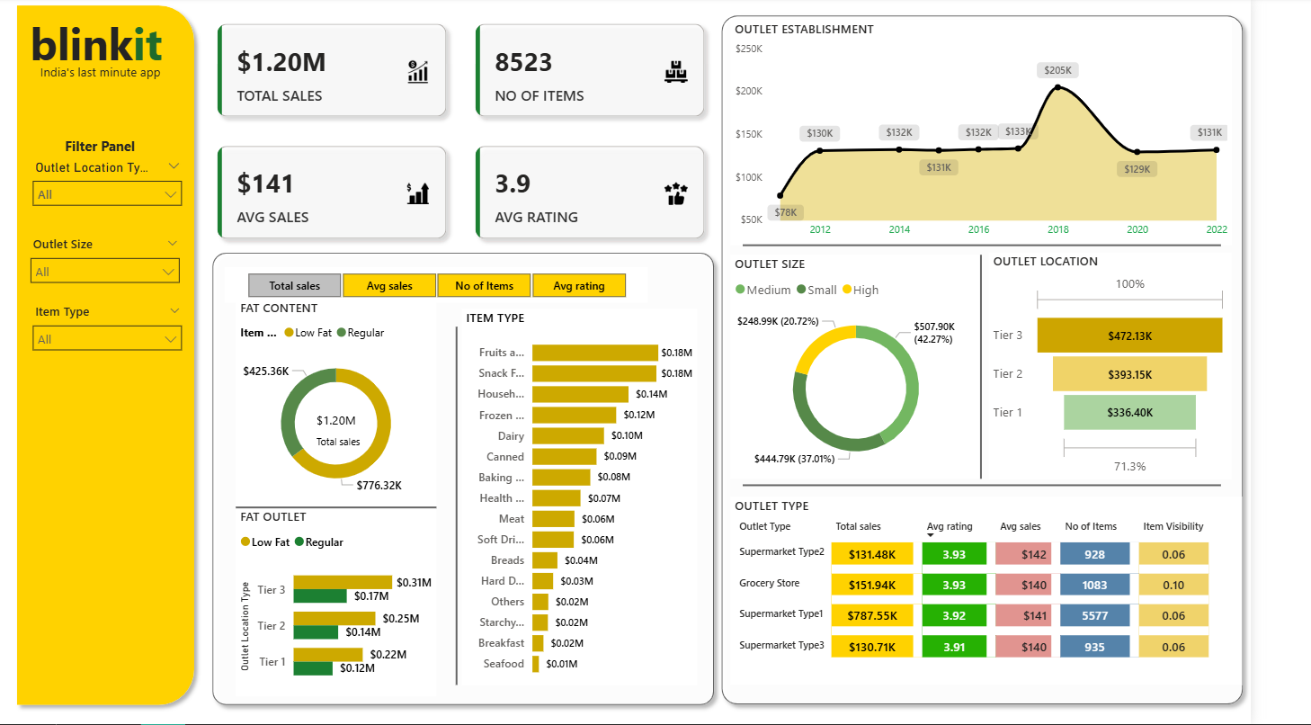
Dasboard

Slide 8

Thank you

